Slide 1

Supporting those that feed our hungry

Slide 2
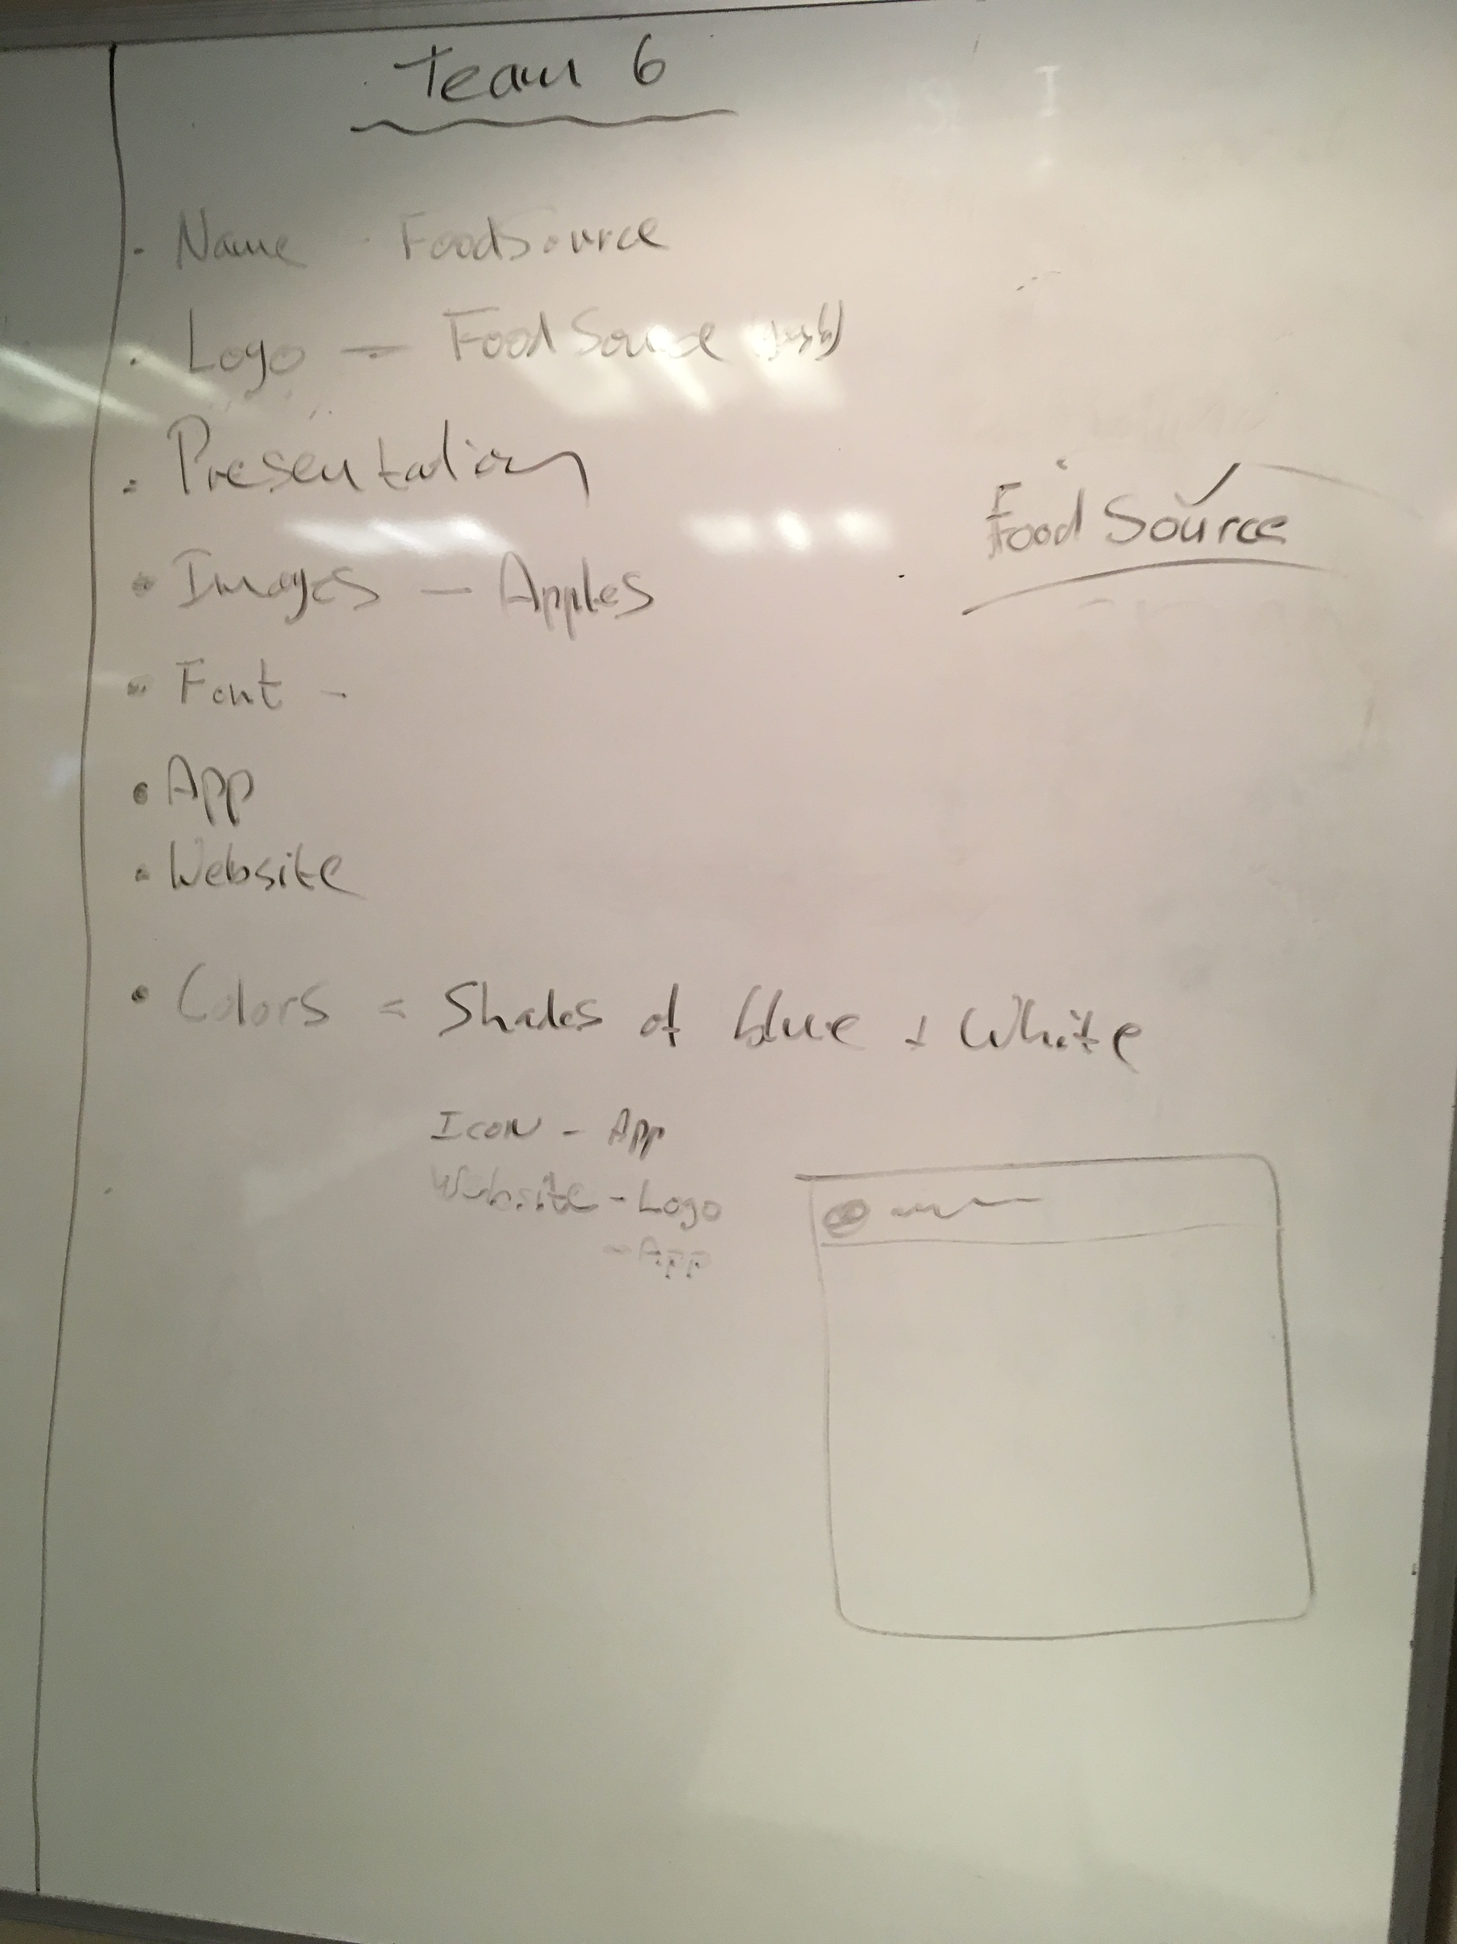
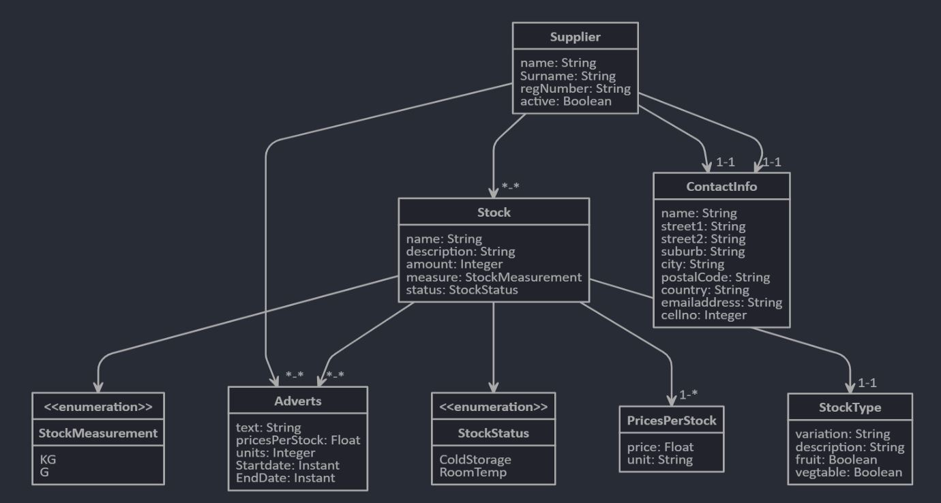
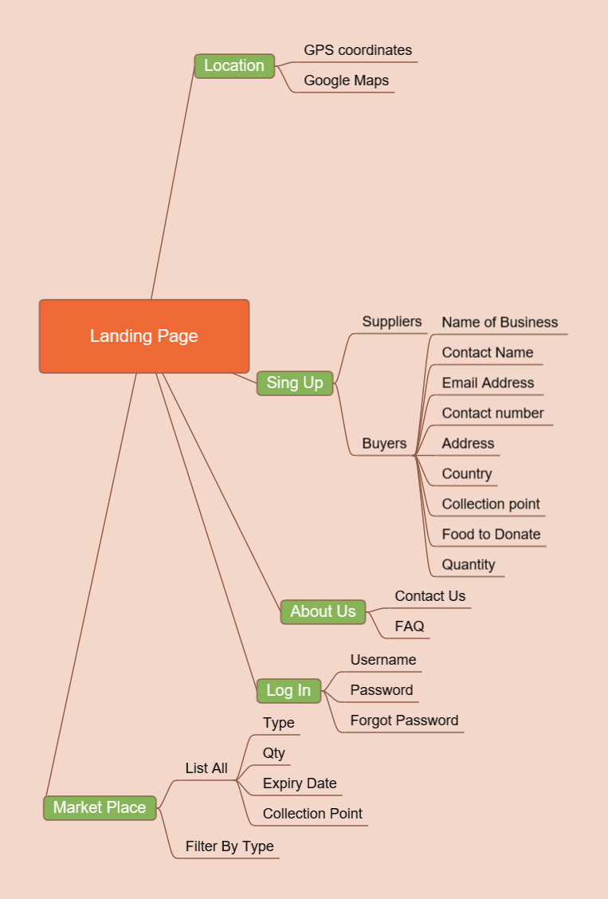
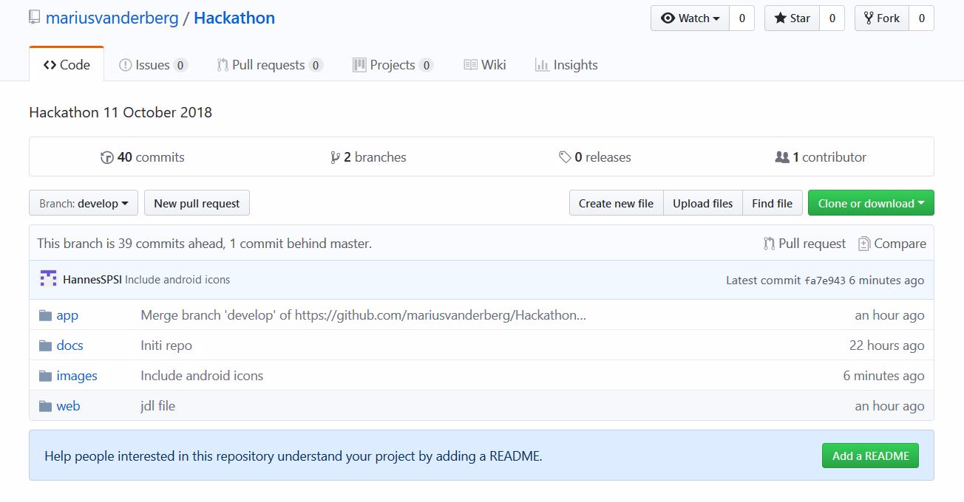
PLANNING THE APP

Slide 3
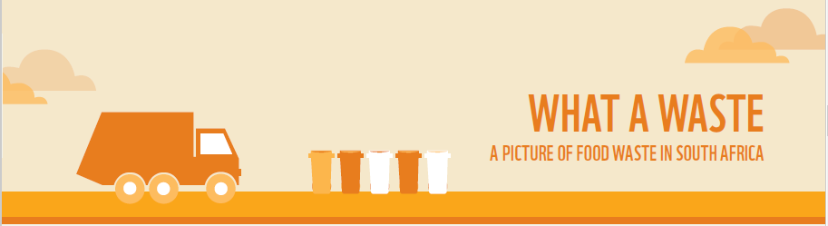
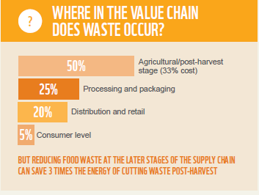
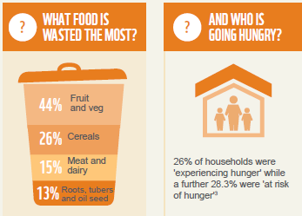
Scope of the APPLICATION
All the food produced in the orchards, fields, pastures, greenhouses, feedlots and fisheries of the world is ultimately intended for consumption. Each apple, will ideally make its way successfully through the various steps of the food supply chain to meet the pressured demand of feeding an increasing global population.

Slide 4
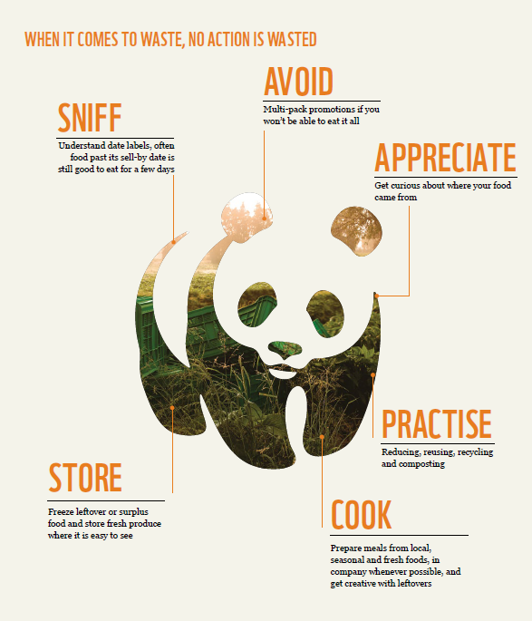
Purpose
The app is based on the following six principles of the World Wide Fund(WWF) for nature.
The purpose of the app is to be the link between the producers and buyers / consumers of otherwise wasted produce, in this case apples.
SNIFF
Visibility on the app on expiry date of the produce on hand
AVOID
App provides quantity that is available of certain produce
APPRECIATE
The app will supply a list of producers which supply the produce
STORE / COOK
Freeze leftovers/surplus, prepare fresh fruit on premises whenever possible
PRACTISE
Reducing, Recycling, Re-using and composting

Slide 5
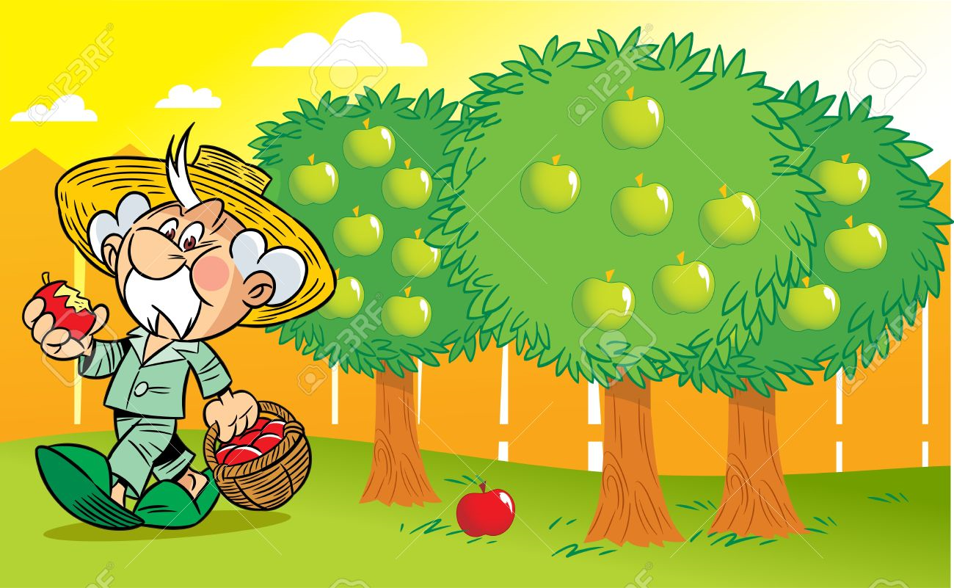
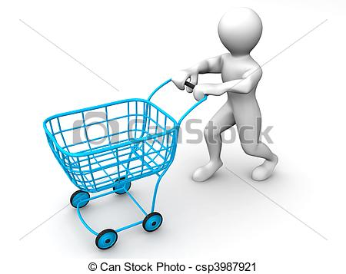

GOAL

Slide 6
DEMO
FoodSource mobile application
FoodSource website

